Slide 1
Development of MEMS based Micropumps for Medical Applications
Shirshendu Chatterjee(T91/ECE/184068)
Roshmi Bhattacharya(T91/ECE/186011)
B.Tech 7th semester
Institute of Radio Physics and Electronics ( IRPE )
University of Calcutta

Slide 2
Contents
Introduction
MEMS and its applications
Wound Therapy
Target of the Project
Design of MEMS based Wound therapy system
Initial Work
Design of Micropumps
Structure Schematic
Working Principle
COMSOL Simulation
Results
Piezoelectric Actuator Simulation
Fluid Transport Simulation
Future Considerations
Fabrication of structures
Design Improvement
System Integration
Application Ranges

Slide 3
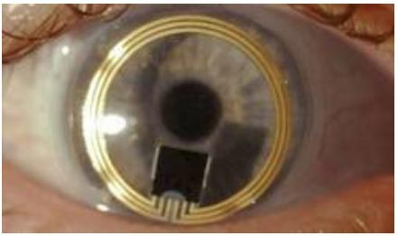
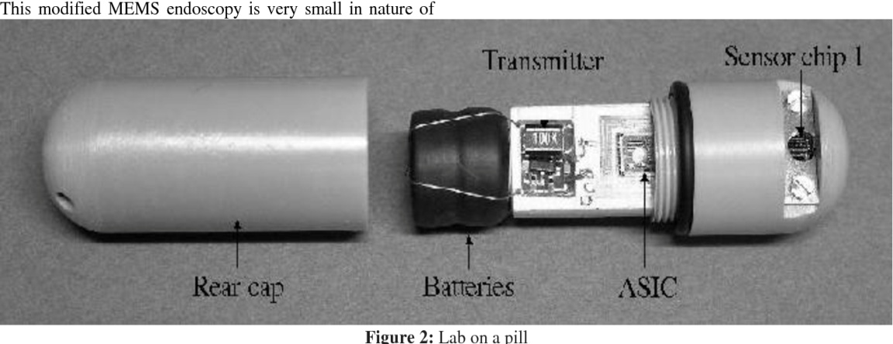
Introduction
MEMS is termed as Micro-Electro-Mechanical Systems.
MEMS have been an important aspect in different domains of technological advancements.
Application of MEMS in medical domain has been elevated in recent years for sensing and actuation purposes.
But, there has been a dearth of MEMS based devices for fast and effective treatment of wounds.
http://www.eeherald.com/section/design-guide/mems_medical.html
Abba, Ibrahim A.. “Role of Microelectromechanical Devices in Improving Human Health.” (2015).

Slide 4
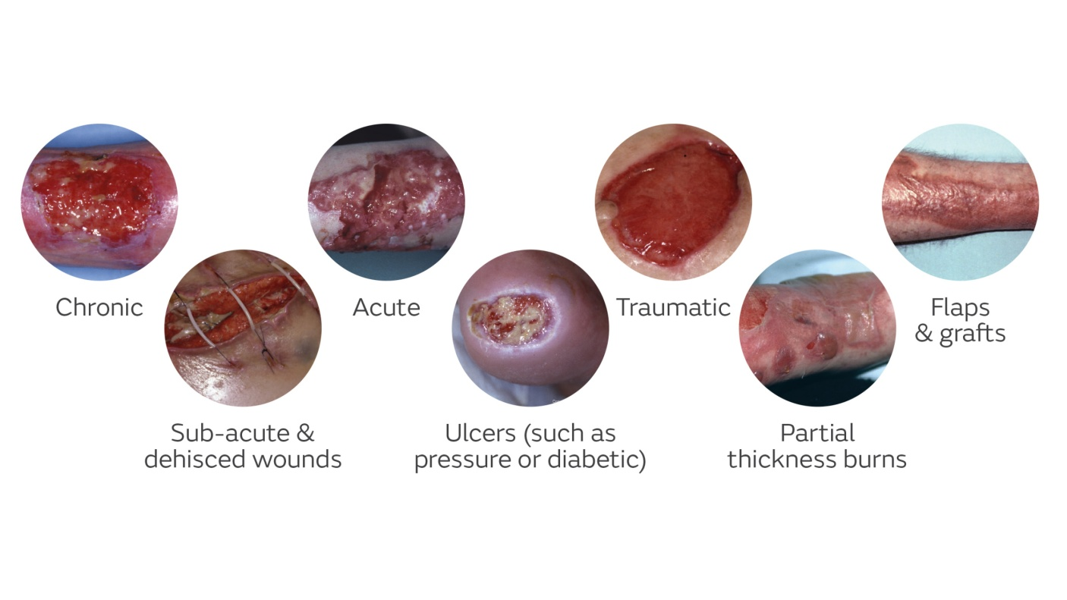
Wound Therapy
Vacuum Assisted Closure or Negative-pressure wound therapy,
It is a therapeutic technique using a suction pump, tubing and a dressing.
Removes excess exudates and promote healing in acute or chronic wounds and second- and third-degree burns.
Figure : NPWT Wound Types

Slide 5
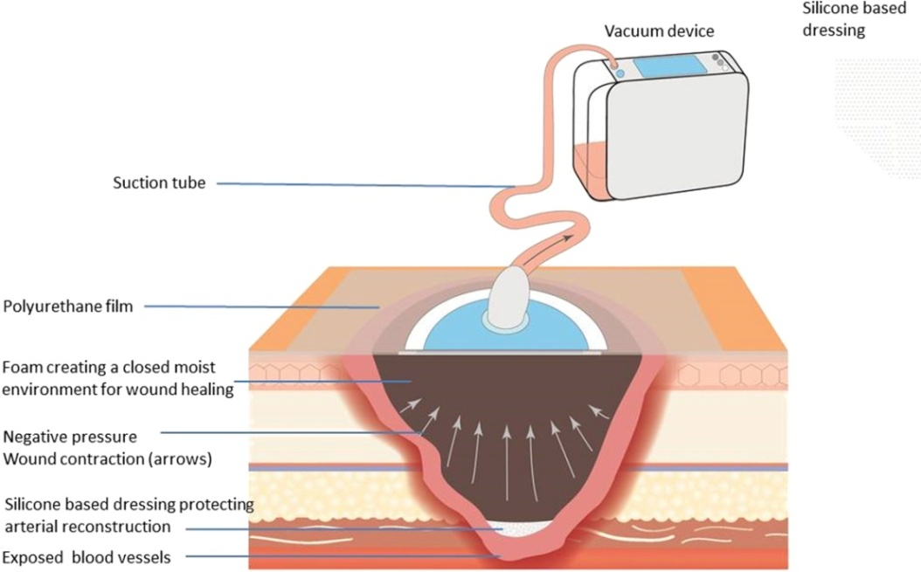
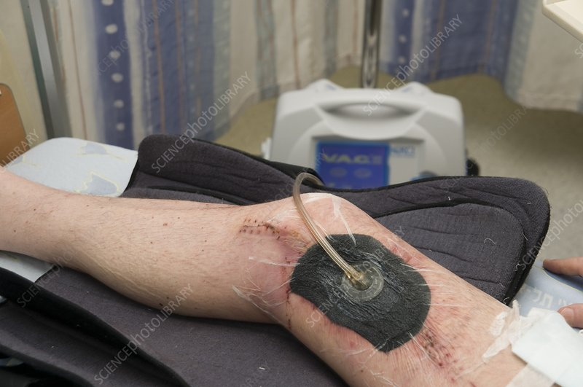
Wound Therapy
How does it work?
Device decreases air pressure on the wound. The gases in the air around us put pressure over the area of the wound.
Induce mechanical stress to tissues and stimulate the division of cell (Mitosis)
Speed of the growth of new blood vessels can be enhanced and wound will be drawn closed toward the center point.

Slide 6
Target of The project
There are no devices to mitigate or heal the wounds inside the body, which serves as the main motivation for our work.
To strike the problem of in-vivo wounds a micropump is to be designed, which will remove the exudates and to keep the wound clean and help fast healing of the wound.
The micropump should be of compact size in the order of millimetres to centimetres.
A sensor will also be incorporated to check the real-time vitals of the patient.
Fabrication of the devices will be done to be ready for implementation.

Slide 7
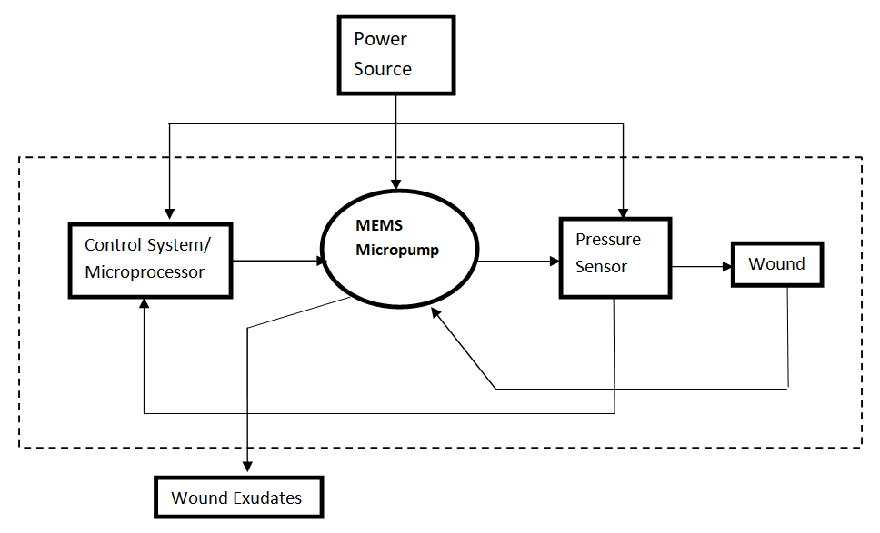
Design of MEMS based Wound therapy system
The schematic of the design of MEMS based wound therapy system is shown.
A power source is applied to the system. The whole pumping mechanism is controlled by a control system.
After pumping the exudates are taken out of the system for further operations.
Figure : overall design of the system

Slide 8
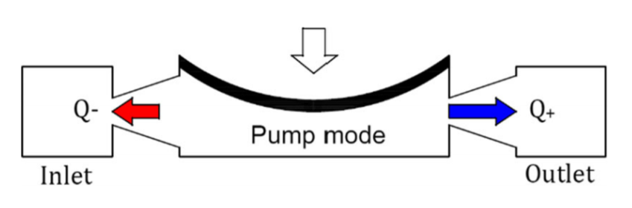
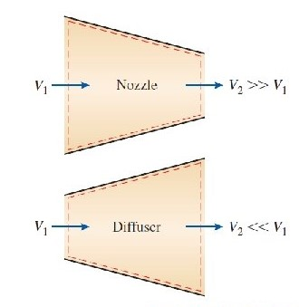
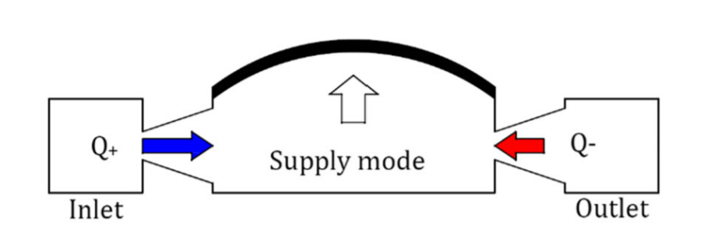
Design of Micropump
Working Principle
There are two modes of operation of the pump-expansion mode, contraction mode.
In Expansion mode, the volume of the pumping section increases more fluid enters the pumping chamber from the diffuser than the nozzle.
In the Contraction mode, more fluid goes out of the element on the left which now acts as a diffuser, while the element on the right acts as a nozzle.
Figure: nozzle/ diffuser diagram
Figure: Modes of operation

Slide 9
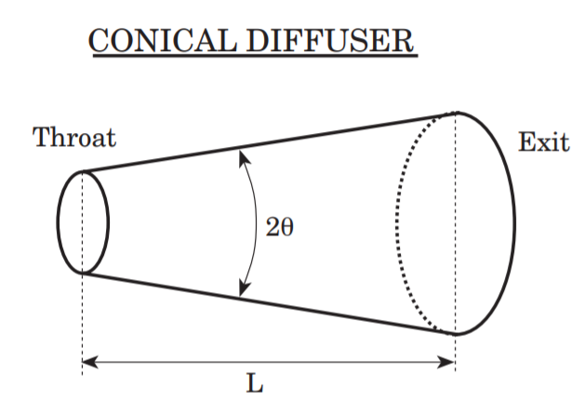

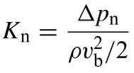
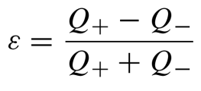
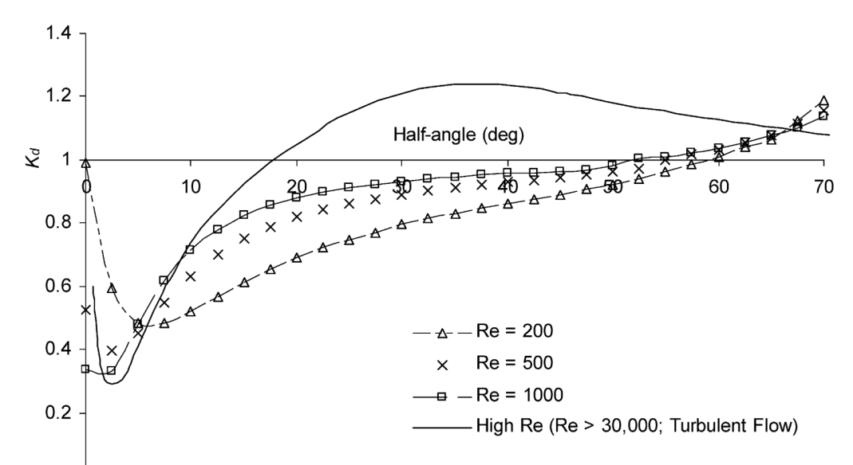
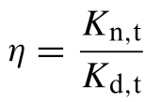
Design of Micropump
Theoretical Analysis
Nozzle diffuser micropump has low cost and simple fabrication.
To analyze the working of the diffuser element,
pressure loss coefficient, flow rectification efficiency
and diffuser efficiency was taken in consideration.
The pressure loss coefficient is defined-
The flow rectification efficiency (Ɛ)is given by-
The nozzle efficiency of the diffuser is –
Diffuser angle should be of 9˚.
Figure: Conical Diffuser
Figure: pressure loss coefficient with half angle

Slide 10
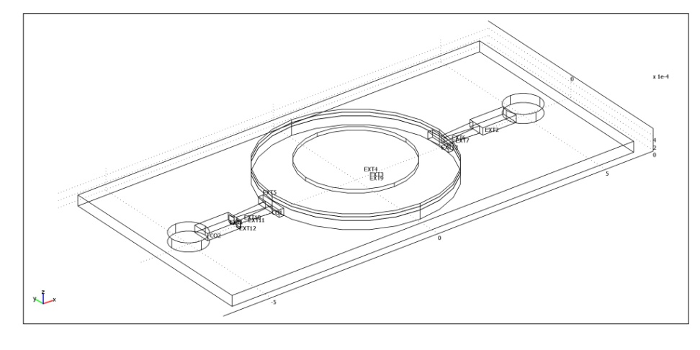
Design of Micropump
Structure Schematic
The structure shows two conical diffuser elements with fully developed inlet chamber.
The fluid goes in the inlet, through the chamber and gets pumped out through the outlet
The chamber is covered by a actuator which changes the pressure inside the chamber thus actuating the pumping action.
The designed micropump is shown below.
The micropump is of size 1.2cm*0.6cm.
Figure: Design of the micropump
30 January 2022
10

Slide 11
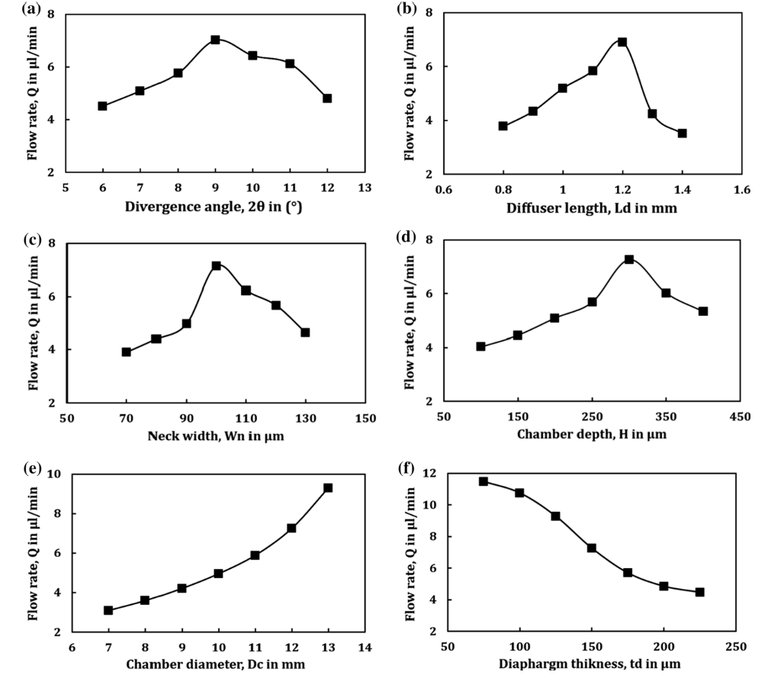
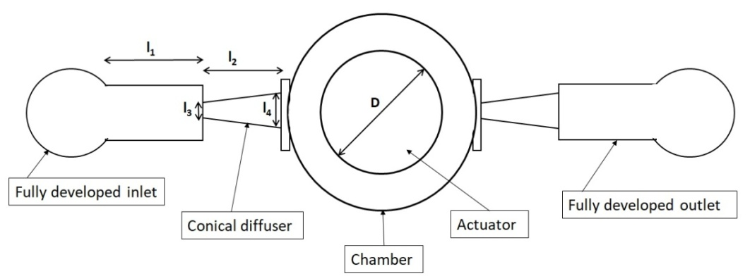
Results in Literature
Dimensions of the Micropump
Description | Value
Length of the inlet chamber(l₁) | 1mm
Length of the diffuser(l₂) | 1mm
Chamber Diameter(D) | 5mm
Actuator Diameter | 3mm
Neck width(l₃) | 100µm
Neck width-outflow(l₄) | 260µm
Ref:Gidde, R.R., Pawar, P.M. & Dhamgaye, V.P. Fully coupled modeling and design of a piezoelectric actuation based valveless micropump for drug delivery application. Microsyst Technol 26, 633–645 (2020).

Slide 12
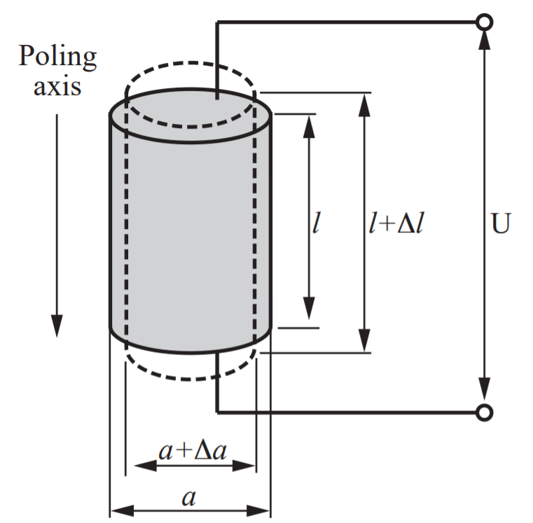
COMSOL SIMULATION
Actuation Principles
Special crystals were subject to mechanical tension, they became electrically polarized and the polarization was proportional to the extension.
The same phenomenon occurs when an electrical voltage is applied, the material gets deformed.
This serves as the main actuating phenomenon for the pumping mechanism for the micropump.
Thorsén, Anders. (1998). Valveless Diffuser Micropumps.

Slide 13
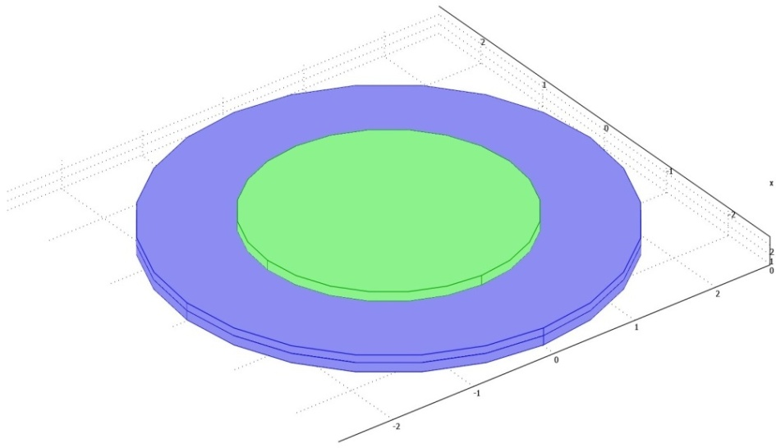
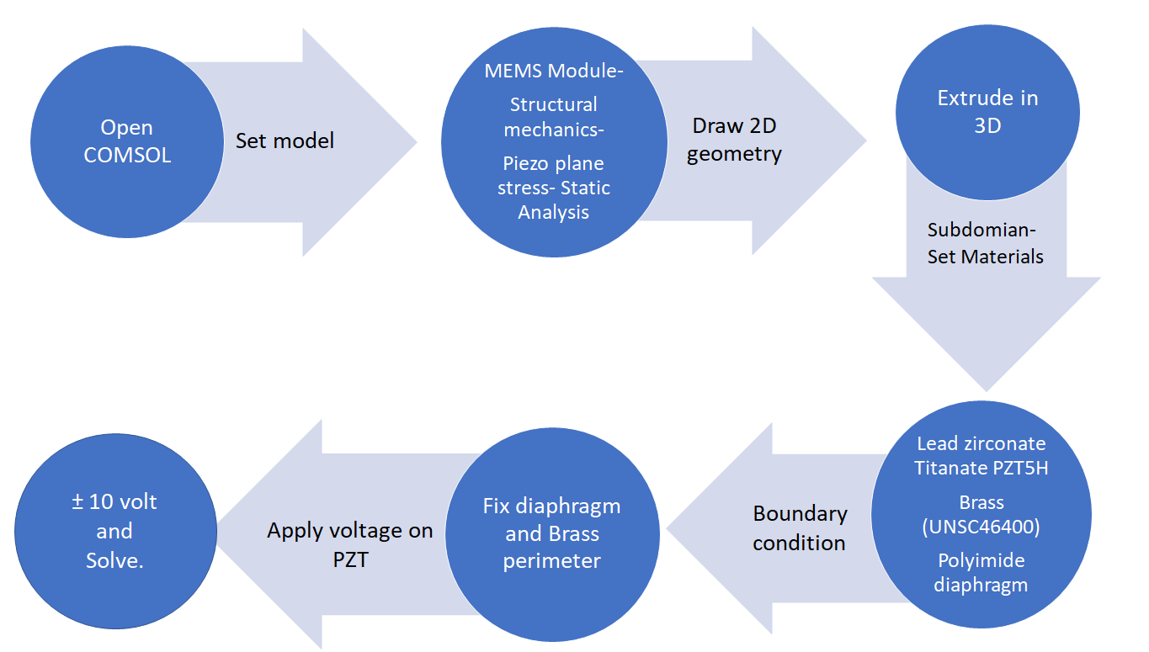
COMSOL Simulation
Piezoelectric Actuator
Description | Value
Diameter and thickness of the Diaphragm | 5mm, 100µm
Diameter and thickness of Brass | 5mm, 100µm
Diameter and thickness of the Piezo Material | 5mm, 100µm
Description | Material Used
Diaphragm | Polyimide
Piezoelectric Actuator | PZT-5H
Substrate | Brass
Figure : Design of actuator

Slide 14
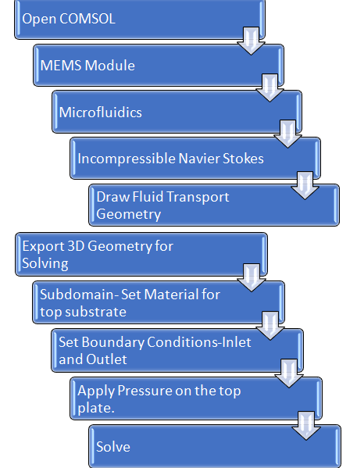
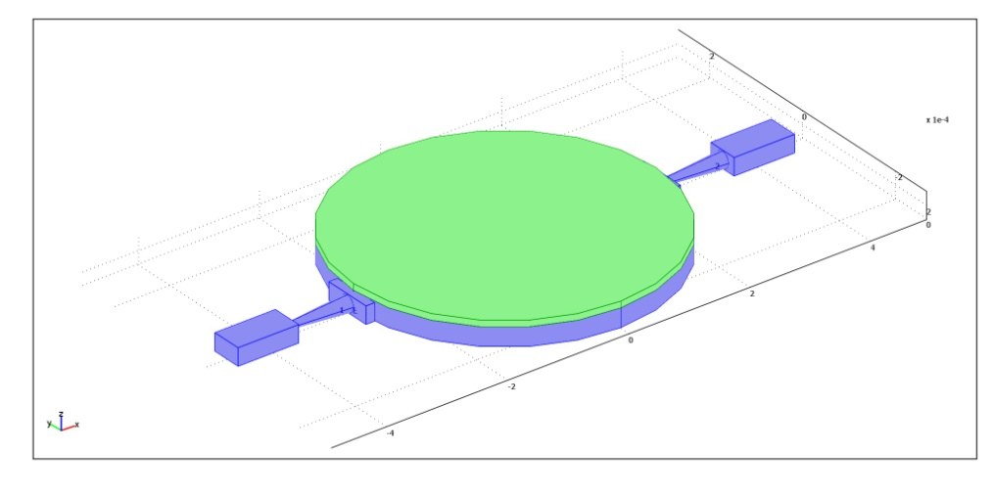
COMSOL Simulation
Fluid Transport Geometry
Description | Value
Width of chamber | 300µm
Top plate thickness | 100µm
Figure: Design of fluid transport structure

Slide 15
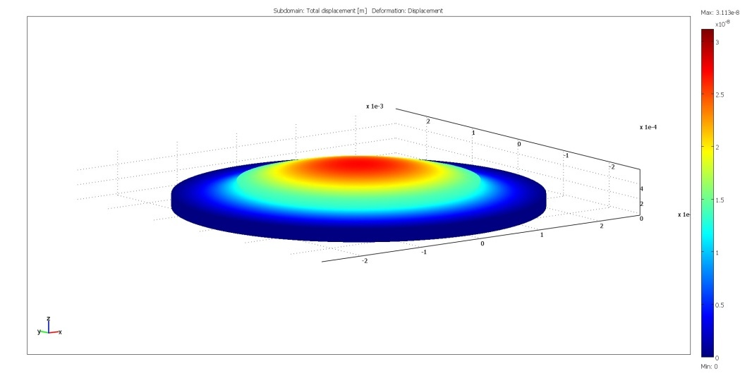
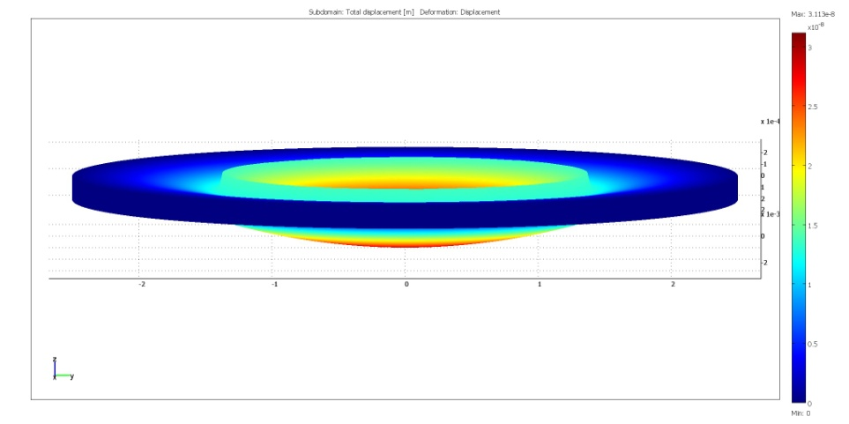
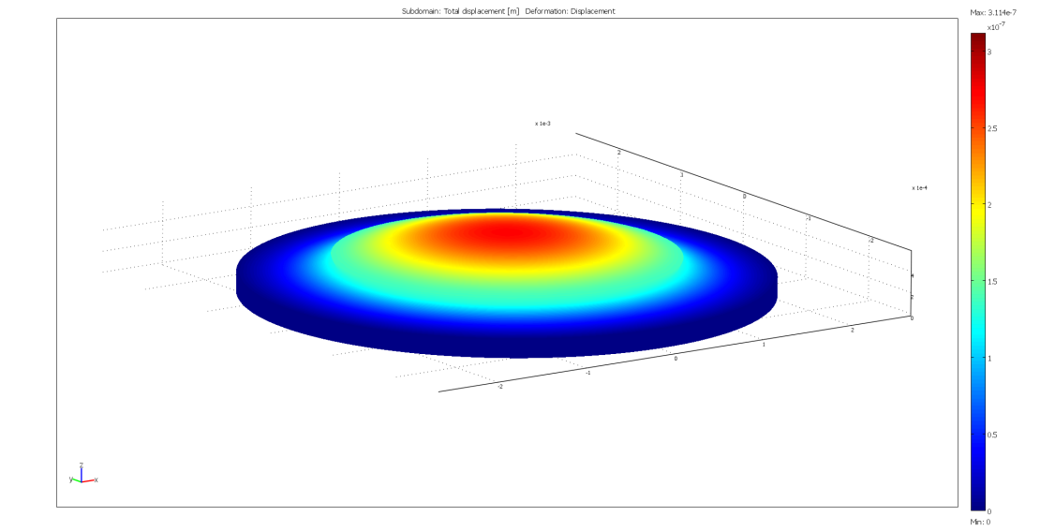
Results
Piezoelectric Simulation-
As a potential of +10V is applied to
the piezoelectric actuator, the
actuator forms a concave surface
and it bends upwards.
When a potential of -10V is applied,
the actuator bends inwards as shown.
Figure: Piezoelectric actuator simulation

Slide 16
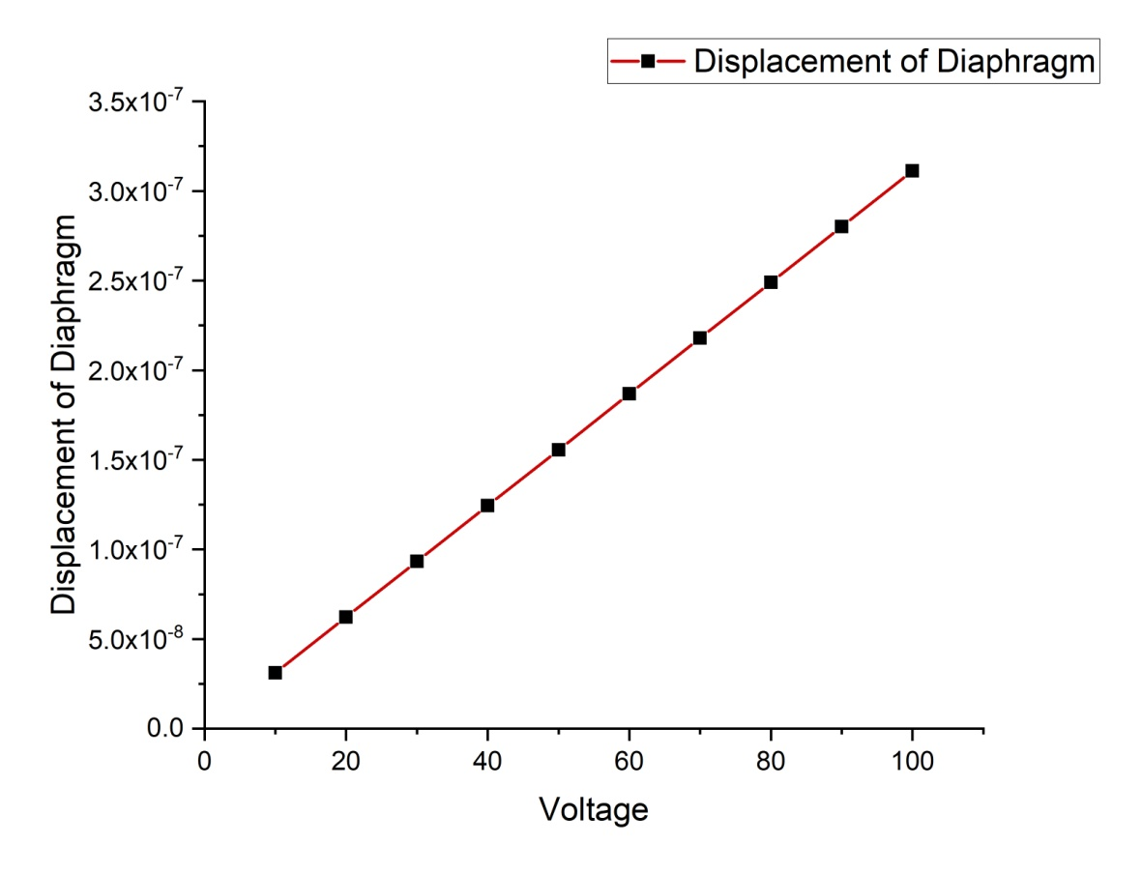
Results
Piezoelectric Simulation-
An analysis of how much there is the deflection of the diaphragm with the change in potential applied was observed.
The graph shows a linear curve, thus depicting linear increase of the diaphragm with the change in voltage.
Figure: Diaphragm displacement with voltage plot

Slide 17
Results
Fluid Transport Simulation-
Inflow characteristics-
The fluid transport of the Micropump was seen.
It is observed a maximum velocity of 0.682m/s near the neck of the diffuser element. The inflow of the fluid is shown.
Figure: Simulation of inflow of fluid transport

Slide 18
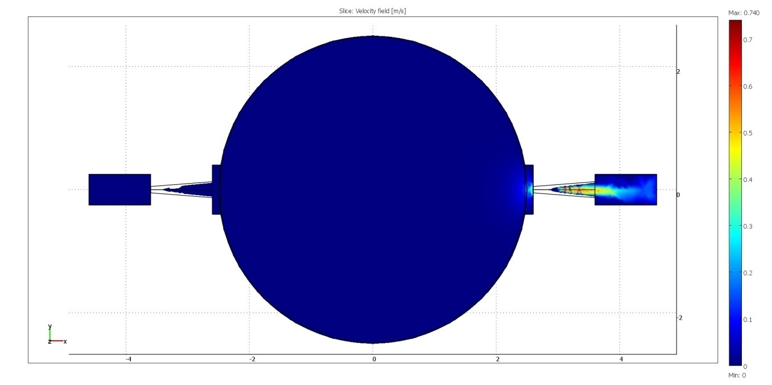
Results
Fluid Transport Simulation-
Outflow characteristics-
Here for the outflow, the boundary conditions was set accordingly.
As the top plate is pressed down, the fluid ejecting out of the chamber with a maximum velocity of 0.740m/s.
Figure: Simulation of outflow of fluid transport

Slide 19
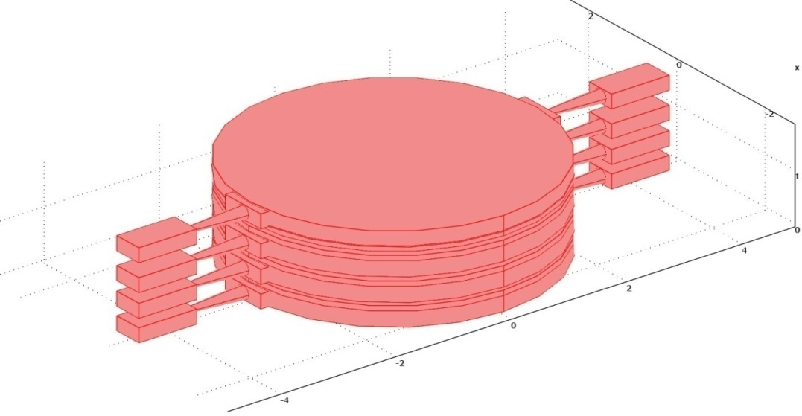
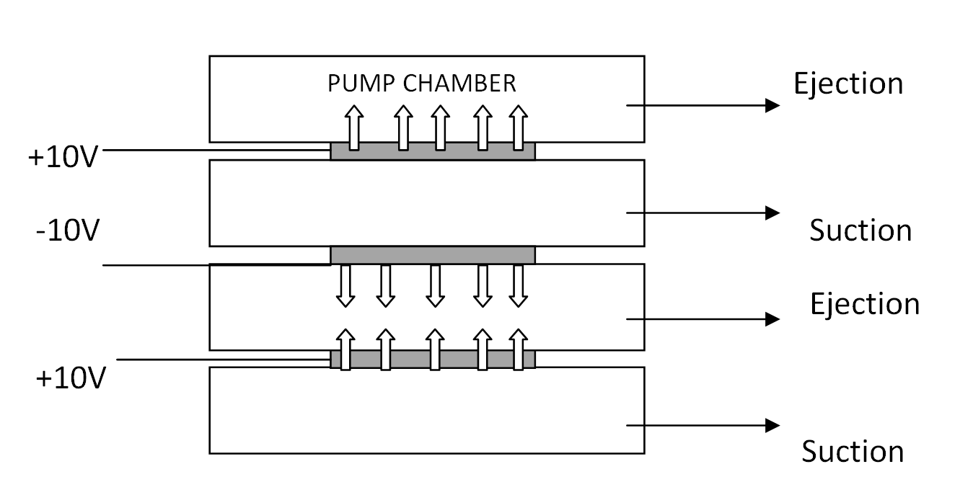
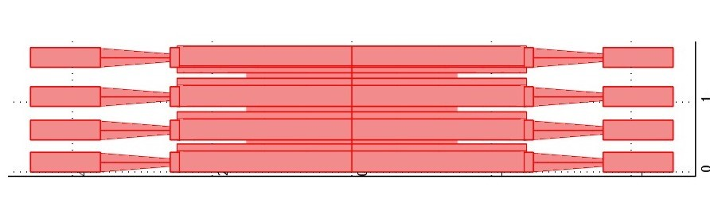
Future Considerations
Design Improvement
As we finish designing a single micropump, the design of such can be extended for modifications to increase the flow rate of the pump.
One such design modification is shown below.
Figure: Design of alternating action micropump

Slide 20
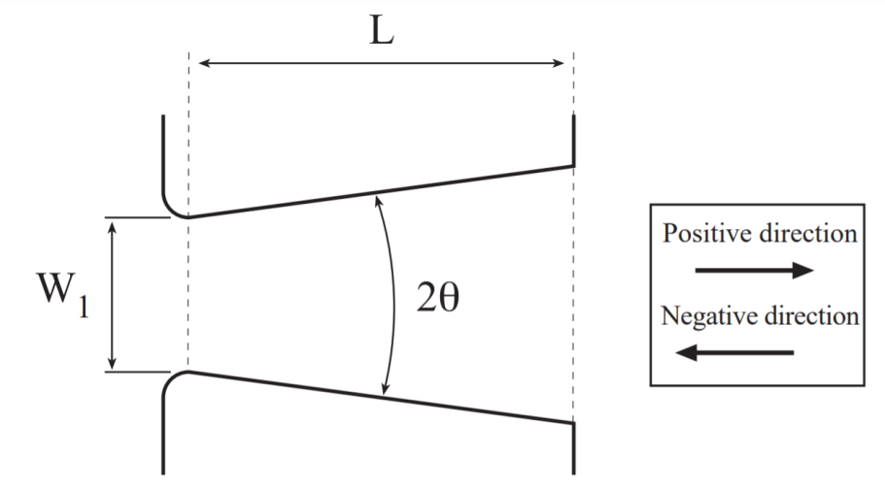
Future Considerations
Design Improvement
A sensor along with the micropump is to be incorporated to check the real-time vitals.
A modification to the inlet of the diffuser is needed to have a more higher diffuser efficiency.
It was seen that a rounded inlet for the diffuser element served more efficiency than sharp inlet boundary.
The rounded inlet geometry is shown below.
Figure: Rounded inlet diffuser element geometry

Slide 21
Future Considerations
Fabrication of Structures
The process flow of the fabrication of the MEMS micropump can be given as-
Firstly, the a 300µm silicon wafer is patterned in the shape of the micropump with the corresponding chamber and two diffuser, inlet-outlet channels using photolithography.
Then, it was etched out to form the required geometry. Isotropic etching is to be done for the conical diffusers and the chamber and the inlet boundary will be anisotropically etched.
Then, the polyimide diaphragm was deposited on the wafer and patterned to give the specific shape.
Then, the piezoelectric actuator with the brass base plate was kept on the diaphragm and joined with epoxy/glue resin.

Slide 22
Future Considerations
System Integration
After fabrication of the devices, the micropump, sensors and others need to be integrated to form a system.
The system to be formed will contain a power source with the control system and other sensors which is required for the working of the device.

Slide 23
Application Ranges
The whole system can have several application in medical domain.
This device can be attached with the front of the imaging probe for endoscopy, and can attach to cuts inside the body after taking samples.
For laparoscopy, cuts of 1-1.5cm is made. Our device’s dimension is sufficient enough to mitigate the cut for such purpose.

Slide 24
REFERENCES
Singhal, Vishal & Garimella, Suresh & Murthy, Jayathi. (2004). Low Reynolds Number Flow through Nozzle-Diffuser Elements in a Valveless Micropumps. Sensors and Actuators A: Physical. 113. 226-235. 10.1016/j.sna.2004.03.002.
Yunas, Jumril & Johari, Juliana & Hamzah, Azlan & Gebeshuber, Ille & Majlis, Burhanuddin. (2010). Design and Fabrication of MEMS Micropumps using Double Sided Etching. Journal of Microelectronics and Electronic Packaging. 7. 44-47. 10.4071/1551-4897-7.1.44.
Bin Fan, Gangbing Song, Fazle Hussain, "Simulation of a piezoelectrically actuated valveless micropump," Proc. SPIE 5389, Smart Structures and Materials 2004: Smart Electronics, MEMS, BioMEMS, and Nanotechnology, (29 July 2004); https://doi.org/10.1117/12.544172
Gidde, R.R., Pawar, P.M. & Dhamgaye, V.P. Fully coupled modeling and design of a piezoelectric actuation based valveless micropump for drug delivery application. Microsyst Technol 26, 633–645 (2020). https://doi.org/10.1007/s00542-019-04535-8
Komatsuzaki, Hiroki & Suzuki, Kenta & Liu, Yingwei & Kosugi, Tatsuya & Ikoma, Ryuta & Youn, Sung-Won & Takahashi, Masaharu & Maeda, Ryutaro & Nishioka, Yasushiro. (2011). Flexible Polyimide Micropump Fabricated Using Hot Embossing. Japanese Journal of Applied Physics. 50. 10.1143/JJAP.50.06GM09.

Slide 25
REFERENCES
Jr-Hung Tsai and Liwei Lin, "A thermal-bubble-actuated micronozzle-diffuser pump," in Journal of Microelectromechanical Systems, vol. 11, no. 6, pp. 665-671, Dec. 2002, doi: 10.1109/JMEMS.2002.802909.
Kalra, Shifali & Nabi, Mashuq. (2017). Implantable Bio-MEMS applications: A review. 131-136. 10.1109/RDCAPE.2017.8358254.
S. Bhattacharjee, R. B. Mishra, D. Devendra and A. M. Hussain, "Simulation and Fabrication of Piezoelectrically Actuated Nozzle/Diffuser Micropump," 2019 IEEE SENSORS, 2019, pp. 1-4, doi: 10.1109/SENSORS43011.2019.8956550.
Thorsén, Anders. (1998). Valveless Diffuser Micropumps.
Santhya, Mohith & P, Navin & Kulkarni, S.. (2020). Performance analysis of valveless micropump with disposable chamber actuated through Amplified Piezo Actuator (APA) for biomedical application. Mechatronics. 67. 102347. 10.1016/j.mechatronics.2020.102347.
T. Wang et al., "Numerical and Experimental Study of Valve-Less Micropump Using Dynamic Multiphysics Model," 2018 IEEE 13th Annual International Conference on Nano/Micro Engineered and Molecular Systems (NEMS), 2018, pp. 300-303, doi: 10.1109/NEMS.2018.8557014.
Chandrasekaran, Arvind & Packirisamy, Muthukumaran. (2012). Experimental investigation of cavitation behavior in valveless micropumps. Journal of Micromechanics and Microengineering. 22. 125019. 10.1088/0960-1317/22/12/125019.

Slide 26
Thank You

